Slide 1
ANNUAL MEETING December 07, 2022

Slide 2
BOARD MEMBERS INTRODUCTIONS
COMMITTEE REPORTS
  SUNSHINE, GREEN SPACE, ARCHITECTURAL & EVENTS
LIGHTING
WEBSITE & EMAIL
AMSDELL ROAD SAFETY IMPROVEMENTS
CULVERT FLOODING
RULES/PAPERWORK/VOLUNTEERING
2022 ACTUAL TO BUDGET REVIEW
2023 BUDGET & VOTE RESULTS
DATO DEVELOPMENT UPDATE
QUESTIONS & ANSWERS
AGENDA
Notes:
Read & Approve MINS – DON

Slide 3
HOMEOWNERS ASSOCIATION’S MISSION
To protect and enhance the VALUE of our homeowners’ property by ensuring architectural integrity, beautiful greenspace, and shared-amenities to create a safe & welcoming neighborhood, providing benefits to all members of the Association.

Slide 4
HOMEOWNERS ASSOCIATION’S ROLE
1. Maintain a Relationship with our Neighbors and be a source of information.
2. Maintain Relationship with border-neighbors
  Town of Hamburg
  Cloverbank Country Club
  DATO Development (PUD by Tracks)
3. Neighborhood Aesthetics & Maintenance

Slide 5
BOARD MEMBERS & OFFICERS
BOARD MEMBERS:
  Don Grundtisch
  Kyle Kraus
  Dennis Lanning
  Patti Michalek
  Gregg Gray
OFFICERS:
  President: Don Grundtisch
  1st Vice President: Terry Nuermburger
  2nd Vice President: Marty Hernik
  Treasurer: Andrea Livsey
  Secretary: Rafael Pignataro
INTRODUCTIONS

Slide 6
SUNSHINE COMMITTEE
13 New Neighbors
Donna Lucas visits new homeowners to deliver gift bags & obtain contact information.
Anyone interested in joining the committee would be greatly appreciated!
Sunny dispositions wanted!
Thank you Donna!
COMMITTEE REPORTS

Slide 7
GREEN SPACE COMMITTEE
Pond Maintenance
  Don & Kyle cleared the brush along the edges of both ponds on Christopher.
  Cattail growth needs to be monitored & treated.
  Don power washed & stained the bridge.
Landscaping & Mowing
  Enser’s Lawn & Landscaping replaced Pace Landscaping this year for the landscaping & mowing service.
  Price quote from Enser’s for 2023 remained the same as 2022.
COMMITTEE REPORTS

Slide 8
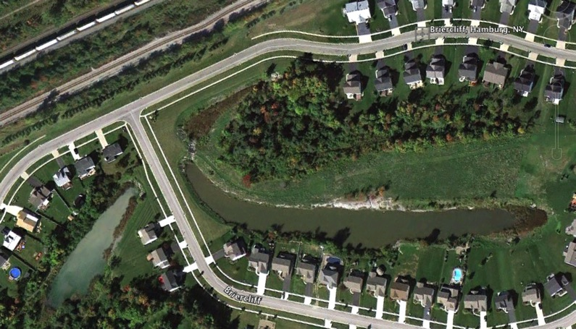
GREENSPACE - The Ponds

Slide 9
ARCHITECTURAL APPROVALS
3 Architectural Requests
Approved
  1 deck
  2 fences
  NOT Approved
  2 fences built without approval
Homeowners with structures on HOA property.
We addressed each of the situations based on their distinct circumstances (3 remain open – sheds/fence)
  The HOA is being added as an additional insured on the homeowner’s insurance policy
  The structures must be removed PRIOR to the homeowner selling
COMMITTEE REPORTS

Slide 10
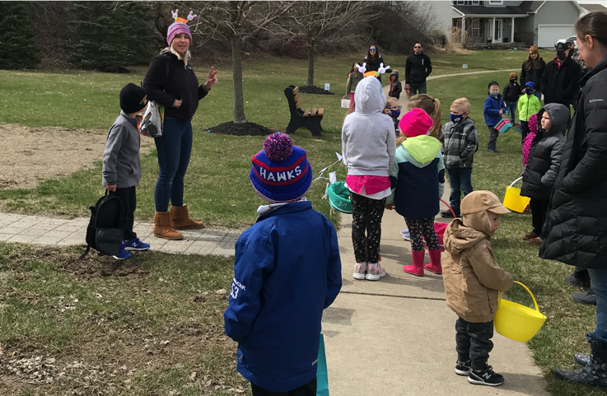
EVENTS COMMITTEE
Lindsay Wahler has organized & run a number of events for the neighborhood over the last few years including
  Easter egg hunt
  A chalk party
  The Briercliff social
  4th of July parade
  A pumpkin cookie decorating event
More volunteers are needed
Thank you Lindsay!
COMMITTEE REPORTS

Slide 11
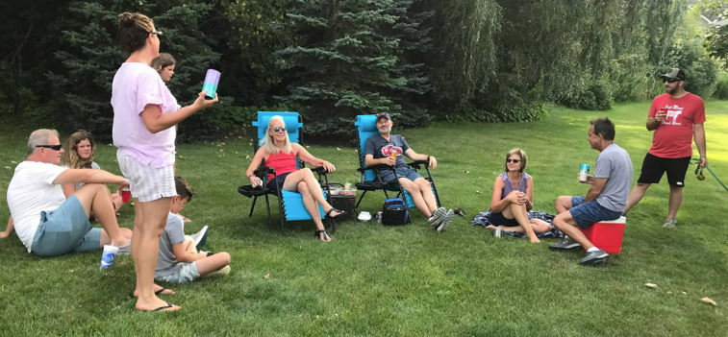
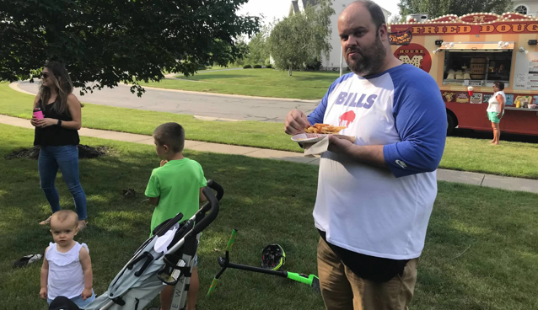
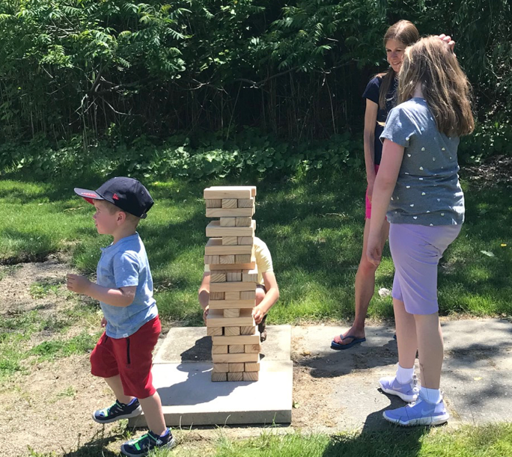
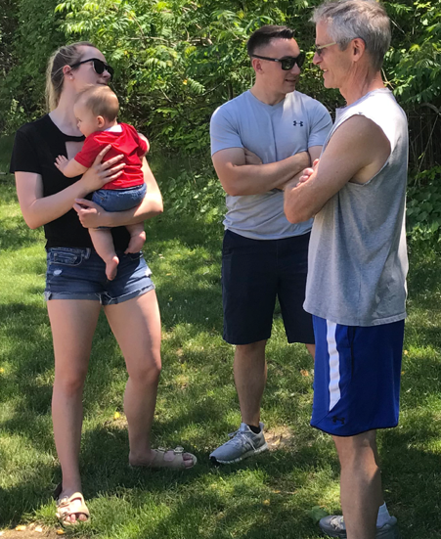
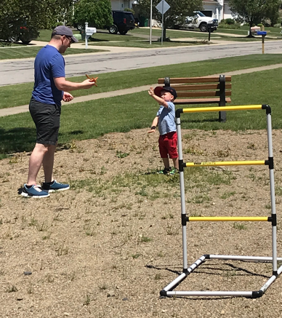
COMMITTEE REPORTS

Slide 12
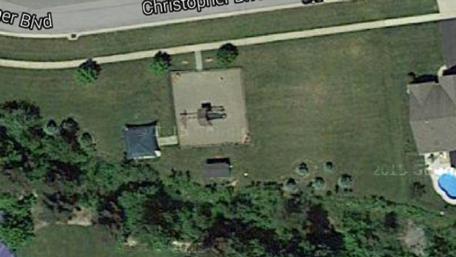

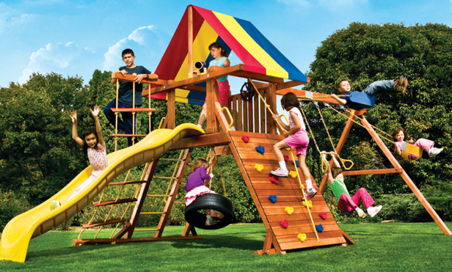
Playground
Proposed Plan Installation of a smaller play-set for 10-years or younger.
Donation of “Like New” Needed
Volunteers to install
Playground Set
Install Fence

Slide 13
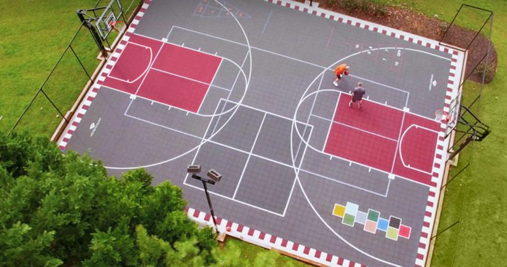
Sports & Events Court
Sports Court | Events Court
Safe Place to Play | A place to gather
Available to ALL kids & All Adults
Brings a LIFESTYLE to our community
Basketball, Pickleball, 4-square, Hockey, Yoga, shuffle-board, etc.
We already have the storage shed
COMMITTEE REPORTS

Slide 14

Sports & Events Court
PHASE 1 - 2021 $21,000 ($30,000 @ $14/sq.ft.)
1. 60’ x 40’ concrete slab $21,000
PHASE 2 - 2022 $9,479
Basketball hoops $4,348
Final grade/topsoil $2,298
Privacy trees $1,533
Rough grade/drainage $1,300
PHASE 3 To Be Determined
Fencing
Custom sports court (volunteered installed)
COMMITTEE REPORTS
Notes:
80 tons of stone, 3 ft drop in elevation

Slide 15
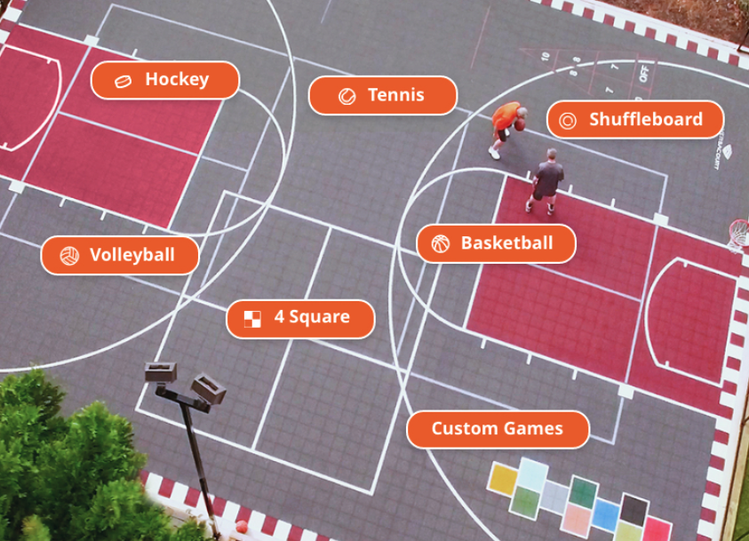
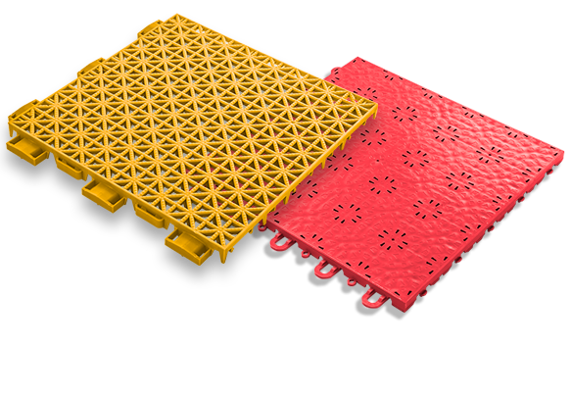
Sports & Events Court

Slide 16
Lighting
Street Lighting
  Town of Hamburg LED light project
    Town has told us that the number of streetlights in our development meets code
    Will monitor when our development will be done.
  Replacement of streetlight heads
    The board will be researching options to replace the streetlight heads & possibly adding a base.
    There are 37 streetlights in our development. Rough estimates to replace the heads is $1,500 to $2,000 each.

Slide 17
New Website
New website launched this year (www.briercliffhomeowners.com)
  We migrated our email to leverage Google’s gmail platform
    Should eliminate the issue of some homeowners not receiving HOA emails.

Slide 18
Amsdell Road School Safety Project
Town has $550k in funding to address Cloverbank & Amsdell Road school safety issues. A committee was set up to determine the use of the funds - the vast majority of which will be spent on Amsdell Road. Don is on the committee along with fellow homeowners Elizabeth Farrell (town councilwoman) & Karen Jones. The plan was finalized & will include sidewalks from the railroad overpass to Route 20 and the construction of 2 crosswalks. One of the crosswalks will be at our entrance at Amsdell. The committee has issued requests for proposals for this work.

Slide 19
Culvert Flooding
Per discussions with the town, the county is responsible for clearing the culvert under the Amsdell Road entrance to prevent the flooding we’ve had in the past. The latest information we have is that the county was looking for a contactor to do the work.

Slide 20
General Neighborhood Reminders
Rules are on the website - BriercliffHomeowners.com
  Enforcement of the rules is necessary to maintain our
  property values.
Facebook.com/BriercliffHOA
or search for BriercliffHOA on your Facebook page
  Request to Join

Slide 21
Good Neighbor Reminders
GARBAGE, BRUSH & LARGE TRASH
  Go out NO EARLIER than 6pm the day before (Wednesday)
  Brought in by the evening of the pick-up day (Thursday)
  REFUSE SERVICE PROVIDER
  Waste Management and Modern Disposal both provide totes for recycling. However, Waste Management picks up the recycling tote once every 2 weeks while Modern Disposal picks up every week.
  2. Clean up after your dog.
  3. To Host an event or social gathering at the recreation area, please SUBMIT a Waiver Application to reserve the space
LARGE TRASH PICK-UP Out on Wednesday night of the 3rd full week
April to October
BRUSH PICK-UP:
Out on SATURDAY before the 2nd full week
March to November

Slide 22
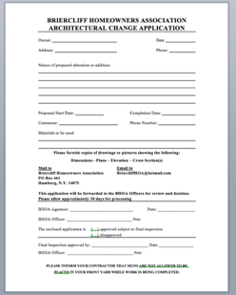
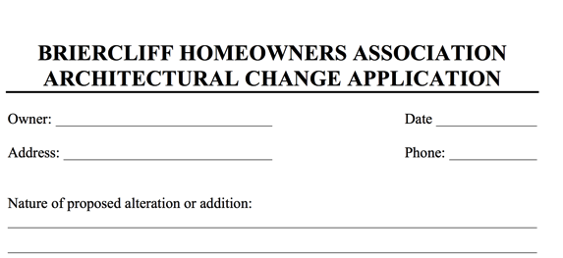
Paperwork Turnaround
If you are adding on to your home, please download and submit the Architectural Approval form at least 2-weeks prior to construction.
If you are selling your home, please have your closing attorney request your closing documents at least 4-weeks prior to your closing. We invoice your attorney a $30 document fee.
Pools
Sheds
Fences
Additions
Notes:
If you are adding on to your home please download and submit the Architectural Approval form at least 2-weeks prior to construction
If you are selling your home, please have your closing attorney request your closing documents at least 4-weeks prior to your closing. This will give you time to remediate anything that is not in compliance – so you don’t hold up your closing!

Slide 23

Volunteering
Several Volunteer Opportunities
May – Earth Day clean up & brush cleanup around the ponds
Spring & Summer – Playground

Slide 24
Budget
  Dues to remain the same at $250/$125
  Board members, officers & volunteers do a lot of work to keep costs down.
  Current project is finishing the sports pad.
  Future projects are pond remediation & replacing the street lights.
  Looking for donated playground for young children.
    The board has the authority to impose a special assessment.

Slide 25
2022 Actual vs Budget

Slide 26
0
2023 Budget
Notes:
Change in officer’s stipends.

Slide 27
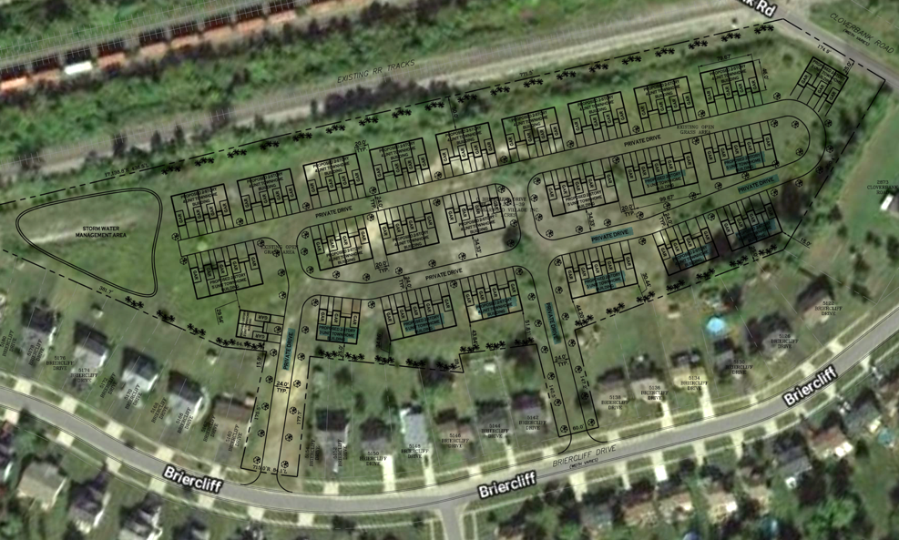
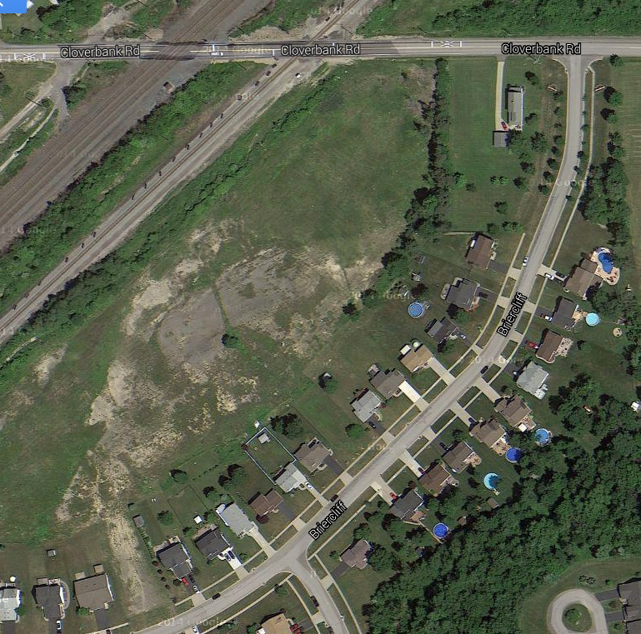
PUD Property by Tracks
Notes:
Planned Unit Development

Slide 28
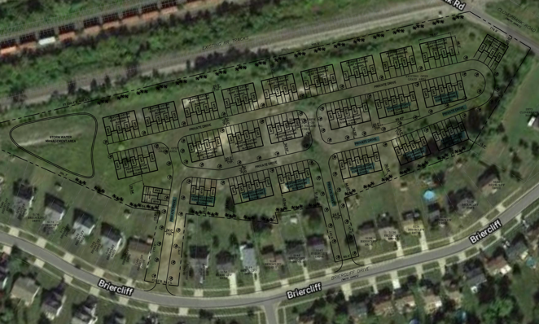
Briercliff Townhomes
Approval Procedure (§230)
The project is considered a townhouse project & must adhere to the townhouse requirements
DATO is submitting updated drawings at the 12/07/22 planning board meeting

Slide 29
0 Briercliff Townhomes
STATUS
  Public hearing regarding the DATO Development project is on the Town of Hamburg planning board’s January 4th agenda.
  We encourage all homeowners to attend
    We have an attorney engaged to fight this proposal.

Slide 30
Budget voting results

Slide 31
THANK YOU

