Slide 1
ANNUAL MEETING December 08, 2021

Slide 2
BOARD MEMBERS INTRODUCTIONS
COMMITTEE REPORTS
  SUNSHINE, GREEN SPACE, ARCHITECTURAL & EVENTS
LIGHTING
WEBSITE & EMAIL
RULES/PAPERWORK/VOLUNTEERING
2021 ACTUAL TO BUDGET REVIEW
2022 BUDGET (DUES INCREASE) & VOTE RESULTS
DATO DEVELOPMENT UPDATE
QUESTIONS & ANSWERS
AGENDA
Notes:
Read & Approve MINS – DON
2011 year – kyle
Committee Reports
Sunshine – Joanne Barba
Green Space – Jim Downey
2011 Budget Review – Tony
20112 Budget Presentation – Tony & Don

Slide 3
HOMEOWNERS ASSOCIATION’S MISSION
To protect and enhance the VALUE of our homeowner-members’ property by ensuring architectural integrity, beautiful greenspace, and shared-amenities to create a safe & welcoming neighborhood, providing benefits to all members of the Association.

Slide 4
HOMEOWNERS ASSOCIATION’S MISSION
Protect & Enhance Home VALUES Enforcement of the rules Keep our neighborhood VERY desirable | Safe Neighborhood Street light project Neighborly Collaboration
Beautiful Greenspace & Amenities Management, Maintenance & Enhancement of: Entrance & Roadside grass & landscaping Corner-parks with benches Play Areas Gazebos & Picnic Area Heart Trail Ponds | Ensuring Architectural Integrity House & Property Aesthetics facades, landscaping, etc. Streetscape cars parked on lawns, trailers / RV’s in driveways, garbage / debris

Slide 5
HOMEOWNERS ASSOCIATION’S ROLE
1. Maintain a Relationship with our Neighbors and be a source of information.
2. Maintain Relationship with border-neighbors
  Town of Hamburg
  Cloverbank Country Club
  DATO Development (PUD by Tracks)
3. Neighborhood Aesthetics & Maintenance

Slide 6
BOARD MEMBERS & OFFICERS
BOARD MEMBERS:
  Don Grundtisch
  Kyle Kraus
  Dennis Lanning
  Patti Michalek
  Gregg Gray
OFFICERS:
  President: Don Grundtisch
  1st Vice President: Terry Nuermburger
  2nd Vice President: Marty Hernik
  Treasurer: Andrea Livsey
  Secretary: Open (Terry Michalek)
INTRODUCTIONS

Slide 7
SUNSHINE COMMITTEE
5 New Neighbors
Donna Lucas visits new homeowners to deliver gift bags & obtain contact information.
Sunny Dispositions wanted!
Thank you Donna
COMMITTEE REPORTS
Notes:
We had 5 new neighbors move into Briercliff.
Donna Lucas visits new homeowners to deliver gift bags & obtain contact information.
Anyone interested in joining the committee would be greatly appreciated!
Thank you Donna!

Slide 8
GREEN SPACE COMMITTEE
Pond Maintenance
  Don & Marty cleared the brush along the edges of both ponds on Christopher.
  New grass path around small pond was mowed by Pace.
  Cattail growth needs to be monitored & treated.
Landscaping & Mowing
  Lawn service companies are expecting significant increase in their lawn mowing fees due to:
    Increased labor costs
    Higher gasoline prices
  We are obtaining a number of competitive quotes
COMMITTEE REPORTS
Notes:
Don & Marty cleared the brush along the edges of both ponds on Christopher.
New grass path around small pond was mowed by Pace.
Cattail growth needs to be monitored & treated.
Pace anticipates a significant increase in their lawn mowing contract due to higher payroll costs driven by increase in minimum wage & higher gasoline prices. We are obtaining competitive quotes.

Slide 9
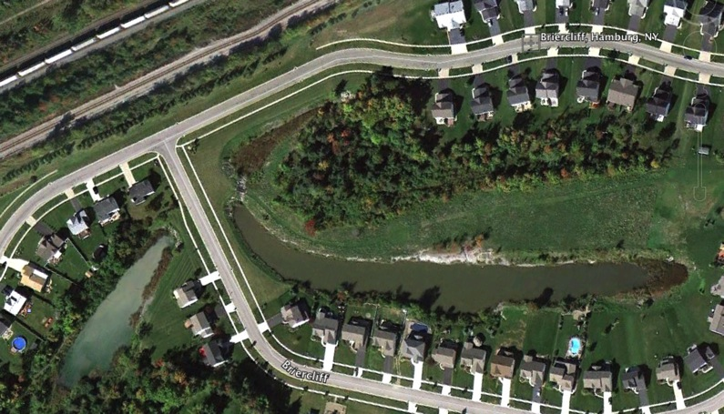
GREENSPACE - The Ponds

Slide 10
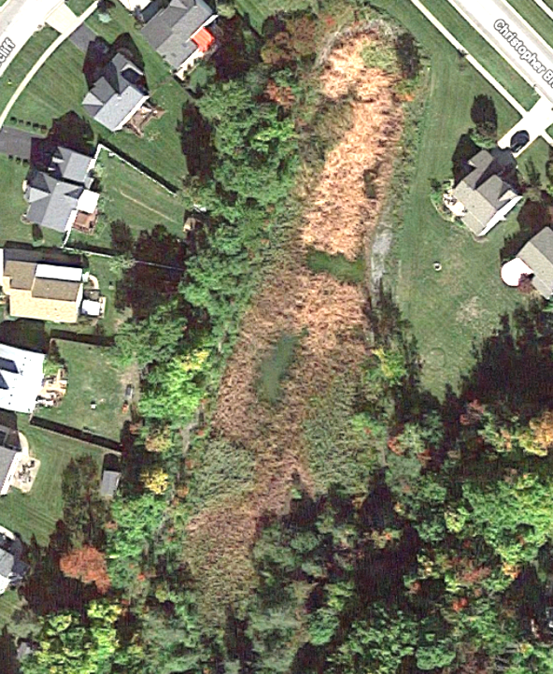
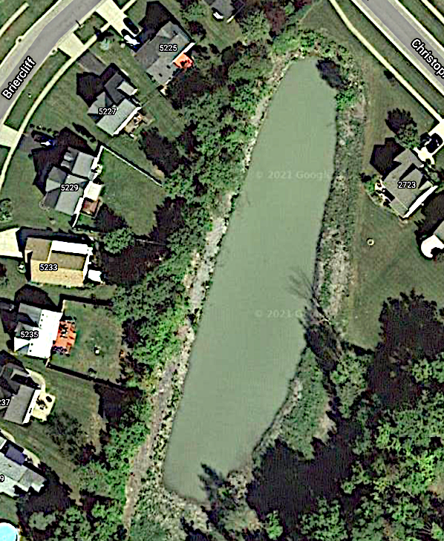
SMALL POND
Decades Of New Life
Usable Grass Areas For Recreation
Walking Trails
Beach-style Entrance
GREENSPACE - The Ponds

Slide 11
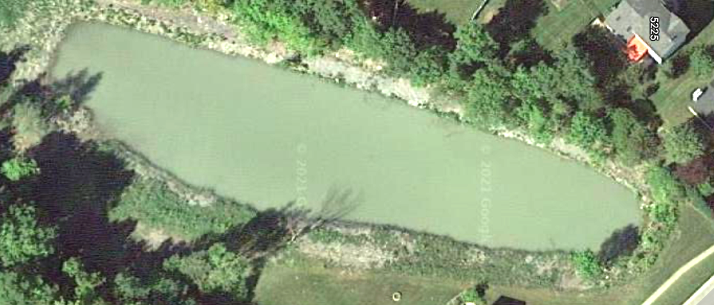
SMALL POND
WALKABLE
TRAILS
SCRUB CUT
IN SPRING
NOW ALL GRASS
GREENSPACE - The Ponds

Slide 12
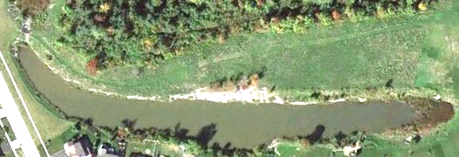
BIG POND
SCRUB CUT
IN SPRING
GREENSPACE - The Ponds

Slide 13
ARCHITECTURAL APPROVALS
3 Architectural Requests
Approved
  1 shed
  1 inground pool
  1 driveway widening
  NOT Approved
  1 shed was built without approval
Homeowners with structures on HOA property.
We are addressing each of the situations based on their distinct circumstances
  The HOA is being added as an additional insured on the homeowner’s insurance policy
  The structures must be removed PRIOR to the homeowner selling
COMMITTEE REPORTS
Notes:
There were 3 Architectural approvals during 2021 –
1 sheds, 1 inground pool & 1 driveway widening.
1 shed was built without approval Yet, meets standards
There are a number of homeowners with structures on HOA property. We are addressing each of the situations based on its distinct circumstances.
For each:
The HOA is being added as an additional insured on the homeowner’s insurance policy
The structures must be removed when the homeowner sells his home.
3 were done under a Psst board president who was not following proper protocals after applying for architectural approvals
Others were done where homeowners did not file for an architectural approval
9 violations issued
5 are now in conformity or have followed the mitigation process
3 remain in place
2 are sheds
1 treehouse / fort

Slide 14
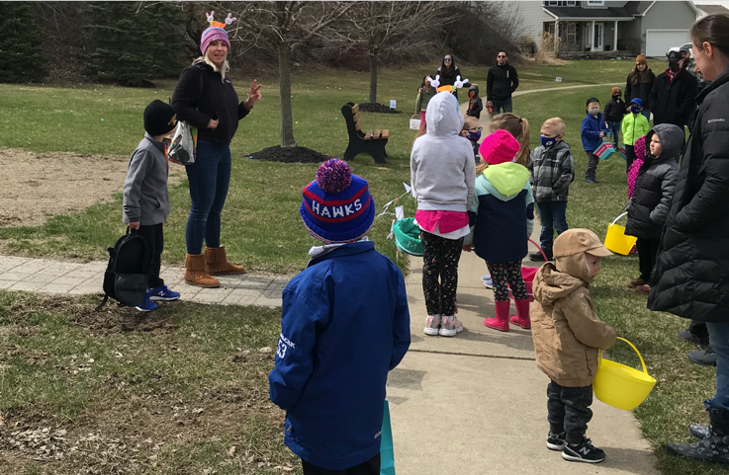
EVENTS COMMITTEE
Lindsay Wahler organized & ran a number of events for the neighborhood including
  Easter egg hunt
  A chalk party
  The Briercliff social
  4th of July parade
  A pumpkin cookie decorating event
More volunteers are needed
Thank you Lindsay!
COMMITTEE REPORTS
Notes:
Lindsay Wahler organized & ran a number of events for the neighborhood including an Easter egg hunt, a chalk party, a Briercliff social, a 4th of July parade and a pumpkin cookie decorating event.

Slide 15
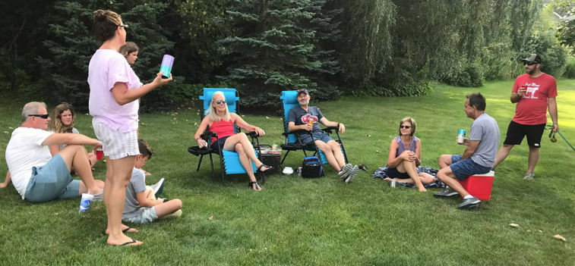
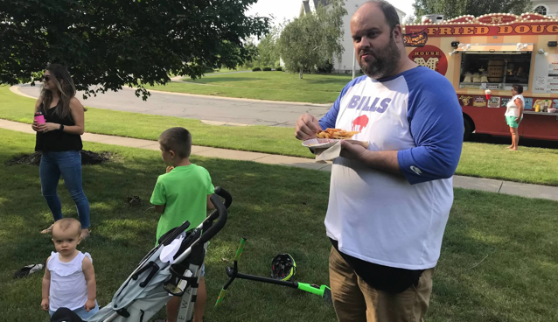
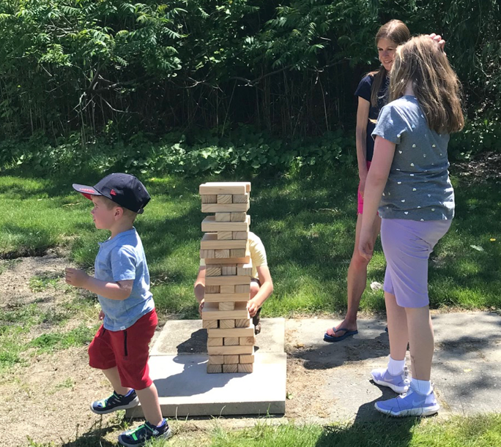
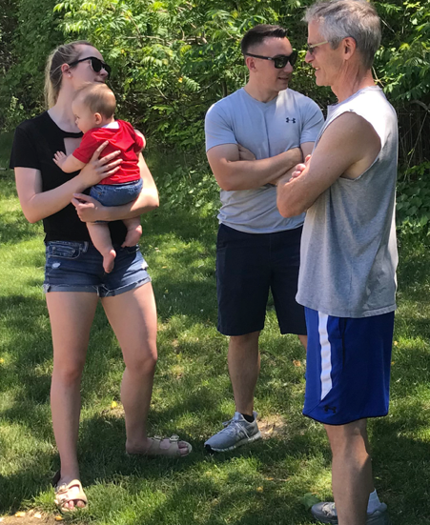
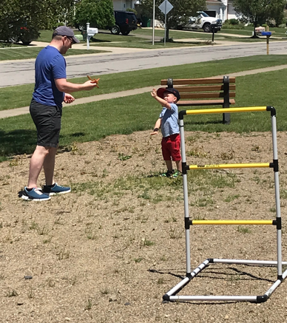
COMMITTEE REPORTS

Slide 16
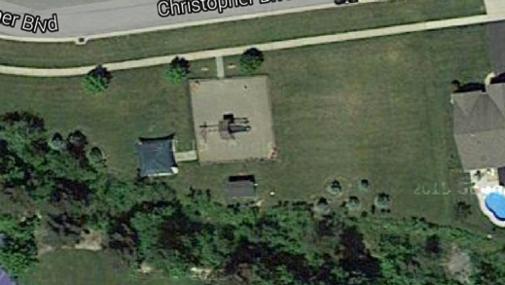

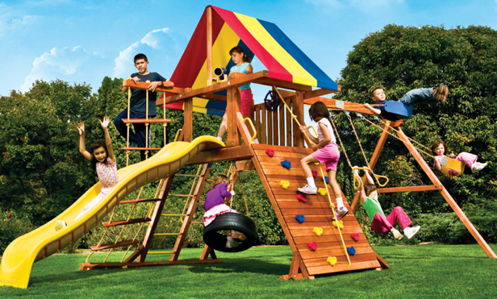
Playground
Proposed Plan Installation of a smaller play-set for 10-years or younger.
Donation of “Like New” Needed
Volunteers to install
Playground Set
Install Fence

Slide 17
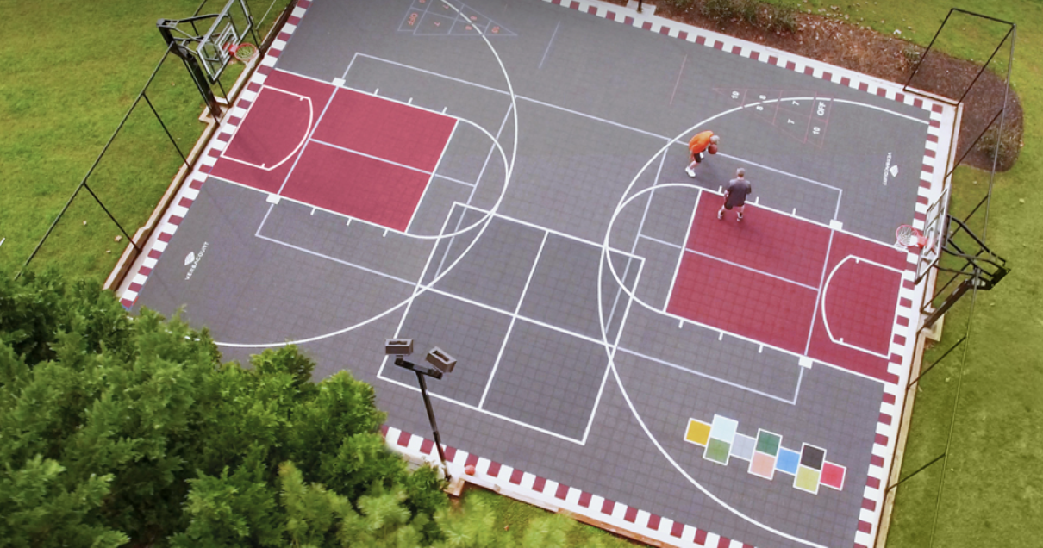
Sports & Events Court
COMMITTEE REPORTS

Slide 18
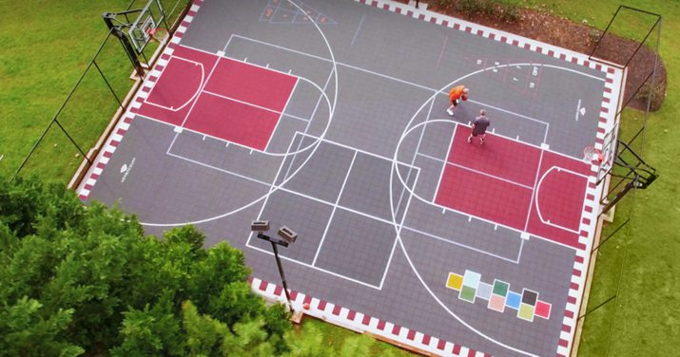
Sports Court
Sports Court | Events Court
Safe Place to Play | A place to gather
Available to ALL kids & All Adults
Brings a LIFESTYLE to our community
Basketball, Pickleball, 4-square, Hockey, Yoga, shuffle-board, etc.
We already have the storage shed
which has never really been used
COMMITTEE REPORTS

Slide 19

Sports Court
PHASE 1 $21,000 ($30,000 @ $14/sq.ft.)
1. 60’ x 40’ concrete slab $21,000
PHASE 2 $10,200
Fencing/netting $3,000
Basketball hoops $3,300
Privacy trees $1,800
Rough grade/drainage $1,700
Final grade $ 400
PHASE 3 $8,000
Custom sports court $8,000 ($12,000)
(volunteered installed)
$38,900
COMMITTEE REPORTS
Notes:
80 tons of stone, 3 ft drop in elevation

Slide 20
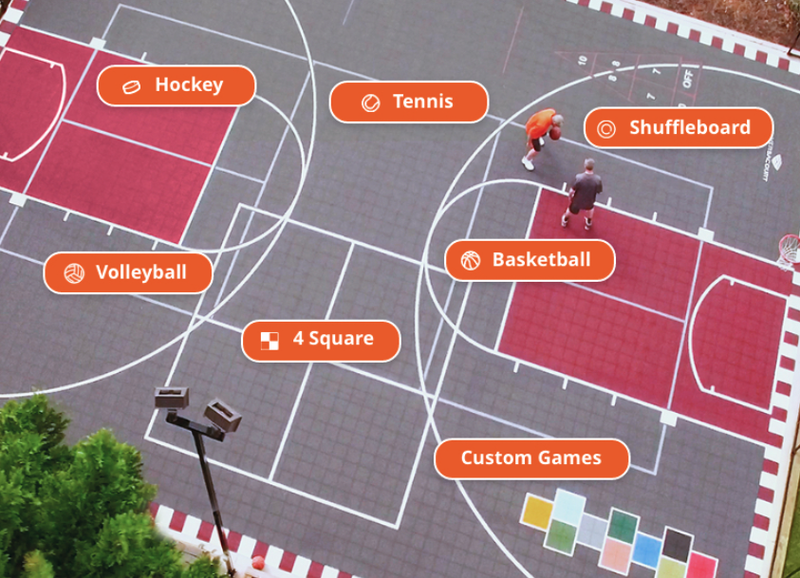
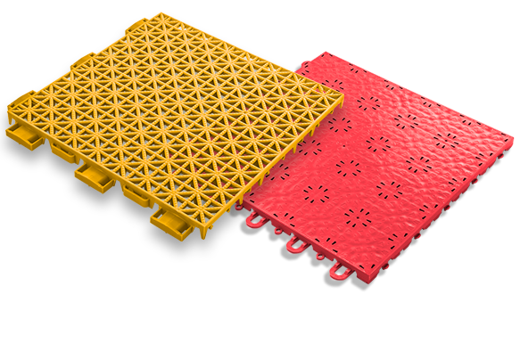
Sports Court

Slide 21
Lighting
Entrance Lighting
  Repaired Amsdell and Cloverbank lighting:
    Repairs completed by homeowner Jerry West at a considerable savings. Thank you Jerry!
      Landscape lighting eye on Cloverbank
      Gazebo lights on Amsdell
    Monument lighting to be addressed in the future.

Slide 22
Lighting (continued)
Street Lighting
  Town of Hamburg LED light project
    Town has told us that the number of streetlights in our development meets code
    Will monitor when our development will be done.
  Replacement of streetlight heads
    The board will be researching options to replace the streetlight heads & possibly adding a base.
    There are 37 streetlights in our development. Rough estimates to replace the heads is $1,500 to $2,000 each.

Slide 23
New Website
New website is in preliminary development stage
  Platform is up
  Now we are now starting to add content
  We are migrating our email to leverage Google’s gmail platform
    should eliminate the issue of some homeowners not receiving HOA emails.

Slide 24
General Neighborhood Reminders
Rules are on the website - BriercliffHomeowners.com
  Enforcement of the rules is necessary to maintain your
  property values.
Facebook.com/BriercliffHOA
or search for BriercliffHOA on your Facebook page
  Request to Join

Slide 25
Good Neighbor Reminders
GARBAGE, BRUSH & LARGE TRASH
  Go out NO EARLIER than 6pm the day before (Wednesday)
  Brought in by the evening of the pick-up day (Thursday)
  REFUSE SERVICE PROVIDER
  Please consider switching from Waste Management to Modern Disposal. Modern supplies a large 95-gallon tote for recycling vs the bins offered by Waste Management which are blown all over the neighborhood.
  2. Clean up after your dog.
  3. To Host an event or social gathering at the recreation area, please SUBMIT a Waiver Application to reserve the space.
LARGE TRASH PICK-UP Out on Wednesday night of the 2nd full week
April 1st to October 31st
BRUSH PICK-UP:
Out on SUNDAY before the 2nd full week
April 1st to October 31st

Slide 26
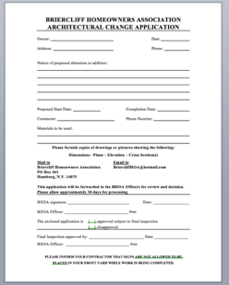
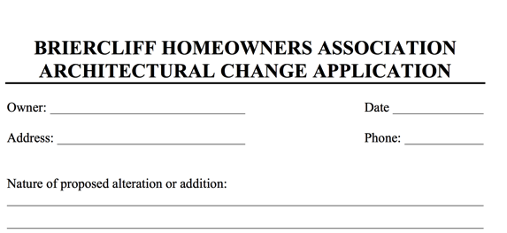
Paperwork Turnaround
If you are adding on to your home, please download and submit the Architectural Approval form at least 2-weeks prior to construction.
If you are selling your home, please have your closing attorney request your closing documents at least 4-weeks prior to your closing. We invoice your attorney a $30 document fee.
Pools
Sheds
Fences (5’-Max)
Additions
Notes:
If you are adding on to your home please download and submit the Architectural Approval form at least 2-weeks prior to construction
If you are selling your home, please have your closing attorney request your closing documents at least 4-weeks prior to your closing. This will give you time to remediate anything that is not in compliance – so you don’t hold up your closing!

Slide 27

Volunteering
Several Volunteer Opportunities
May – Earth Day clean up & brush cleanup around the ponds
Spring & Summer – Playground
Support our efforts in safe-guarding our interests in the 0 Briercliff Townhome project

Slide 28
Budget
  Dues have held steady 20 years.
  Perspective
    Brierwood HOA is 95 houses at $200 – they only mow a small area and maintain the entrances
    Avg inflation rate of 2.28% per year between 2000 and today, cumulative price increase of 60.62%. - Bureau of Labor and statistics
    Dues should be $352
  Increase to $250/$125 (additional $2.50/$1.25 per mo.)
    Cover increasing landscaping/lawn cutting costs and large future pond remediation & other projects.
    The board has the authority to impose a special assessment.
Notes:
We have kept costs down by volunteers and board members “actually doing the labor and work”
Year 2 add 2 hoops $5k and sports court material $6k ($11k)
Need to fund a young Kid
Need a donated playground
We have fencing & Stone

Slide 29
Budget
  Increase from $220/$110 to $250/$125
  (additional $2.50/$1.25 per mo.)
  Cover increasing landscaping/lawn cutting costs and large future pond remediation & other projects
  Cost of attorneys for opposing the DATO project
  OR
  When we have a shortfall next year, the board will be forced to use its authority to impose a special assessment. Not what we want to do.
Notes:
We have kept costs down by volunteers and board members “actually doing the labor and work”
Year 2 add 2 hoops $5k and sports court material $6k ($11k)
Need to fund a young Kid
Need a donated playground
We have fencing & Stone

Slide 30
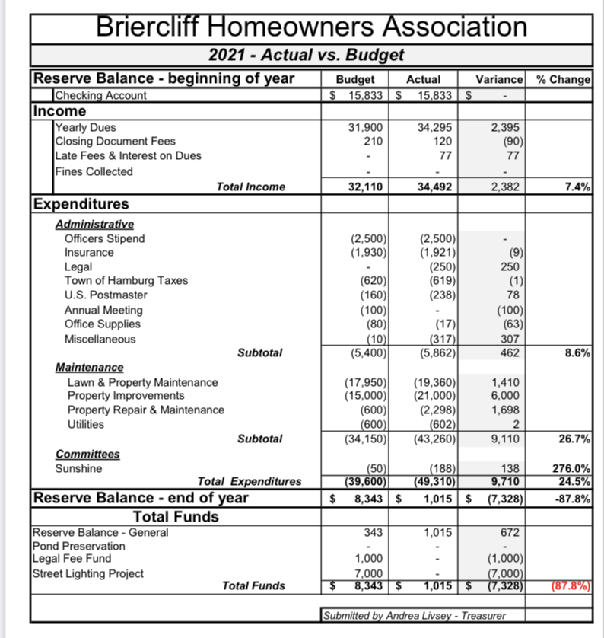
2021 Actual vs Budget

Slide 31
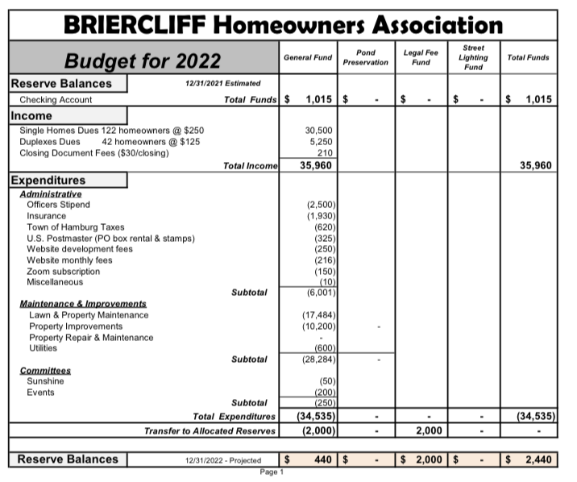
2022 Budget
Notes:
Change in officer’s stipends.

Slide 32
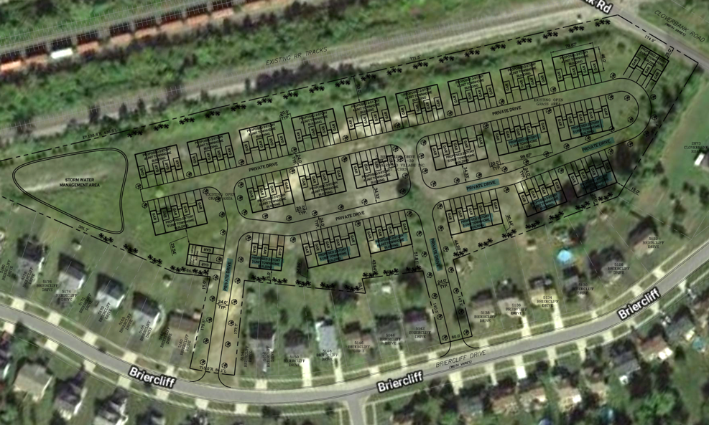
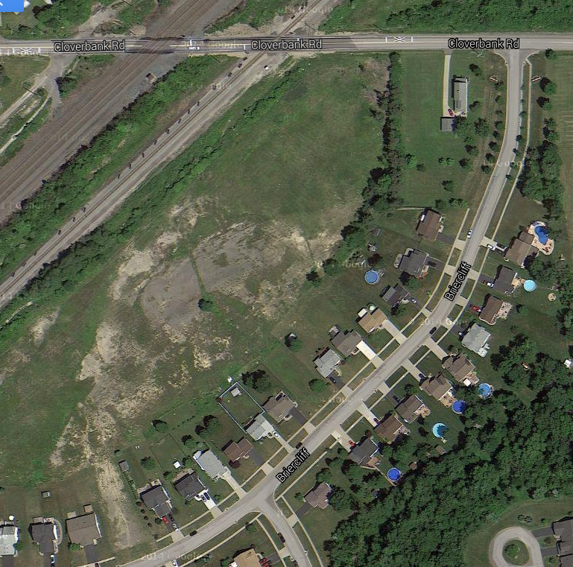
PUD Property by Tracks
Notes:
Chatter about low rise apartment complex – Planned Unit Development

Slide 33
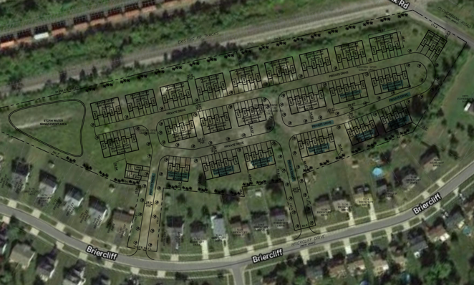
Briercliff Townhomes
Approval Procedure (§230)
Sketch plan submitted
Submission of their preliminary plat, approval.
  SEQR (Env. Quality Review)
  EIS (Env. Impact Study)
Preliminary plat.
  Public Hearing with 62 Days
  Within 45 days after the hearing, Board shall approve or disapprove
  Re-subdivision procedures

Slide 34
0 Briercliff Townhomes
STATUS
  DATO Development is on the Town of Hamburg’s December 15th agenda.
    We plan on attending the meeting & will communicate a summary of what transpires.
    We’ll determine a game plan based on the results of the meeting.
Notes:
receive the environmental paperwork yesterday and will be sending it out to the DOT, DEC, County etc. today. So I anticipate them asking to be on an agenda perhaps in early December.

Slide 35
Budget voting results

Slide 36
THANK YOU
Notes:
Challenges with closings this year due to NON-Architectural Compliance.
We are working on Retrospect Architectural items to be brought up to speed

