Slide 1
ANNUAL MEETING December 11, 2024

Slide 2
HOA’S MISSION & ROLE
BOARD MEMBERS INTRODUCTIONS
COMMITTEE REPORTS
  SUNSHINE, GREEN SPACE, ARCHITECTURAL & EVENTS
AMSDELL ROAD SCHOOL SAFETY PROJECT
CULVERT FLOODING
RULES/PAPERWORK/VOLUNTEERING
2024 ACTUAL TO BUDGET REVIEW
2025 BUDGET & VOTE RESULTS
DATO DEVELOPMENT UPDATE
QUESTIONS & ANSWERS
AGENDA
Notes:
Read & Approve MINS – DON

Slide 3
HOMEOWNERS ASSOCIATION’S MISSION
To protect and enhance the VALUE of our homeowners’ property by ensuring architectural integrity, recreational greenspace and shared amenities providing benefits to all members of the Association.

Slide 4
HOMEOWNERS ASSOCIATION’S ROLE
1. Maintain a relationship with our homeowners and be a source of information.
2. Maintain relationship with bordering neighbors
  Town of Hamburg
  Cloverbank Country Club
  Sawgrass Court
  DATO Development (PUD by Tracks)
3. Responsible for our neighborhood aesthetics & maintenance

Slide 5
BOARD MEMBERS & OFFICERS
BOARD MEMBERS:
  Don Grundtisch
  Dennis Lanning
  Patti Michalek
  Kyle Kraus
OFFICERS:
  President: Don Grundtisch
  1st Vice President: Jeff Crossett
  2nd Vice President: Matt Maciejewski
  Treasurer: Andrea Livsey
  Secretary: Kim Buck
INTRODUCTIONS

Slide 6
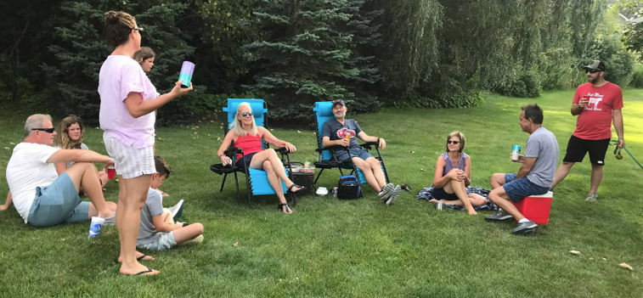
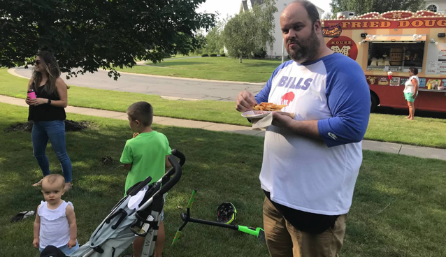
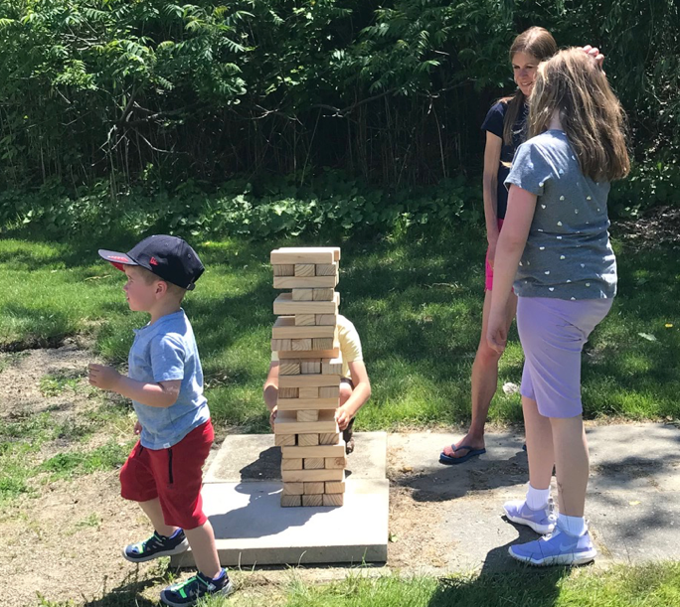
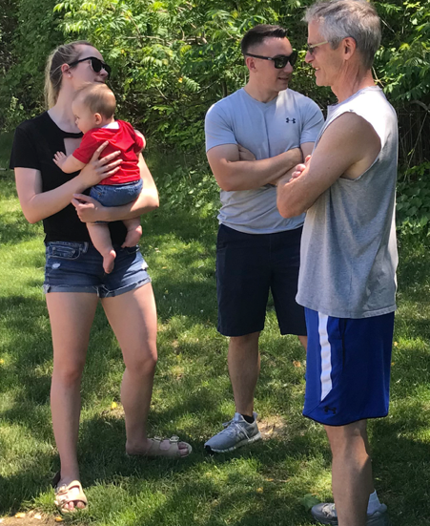
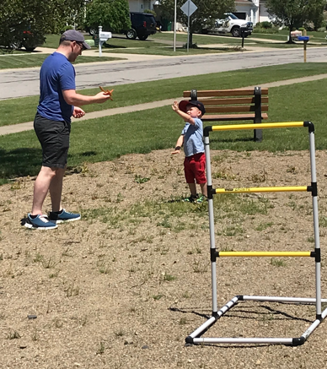
COMMITTEE REPORTS

Slide 7
SUNSHINE COMMITTEE
10 New Neighbors
Donna Lucas visits new homeowners to deliver gift bags & obtain contact information.
Anyone interested in joining the committee would be greatly appreciated!
Sunny dispositions wanted!
Thank you Donna!
COMMITTEE REPORTS

Slide 8
GREEN SPACE COMMITTEE
Pond Maintenance
  Eastern end of the large pond was cleaned up & graded.
  The small pond & the western end of the large pond will be brush hogged in 2025.
  Gazebos
  The gazebos were caulked & painted.
Landscaping & Mowing
  Enser’s Lawn & Landscaping provides the landscaping & mowing service for our association.
  Price quote from Enser’s for 2025 increased by 2% from 2024.
COMMITTEE REPORTS

Slide 9
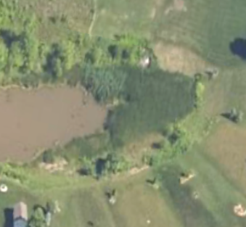
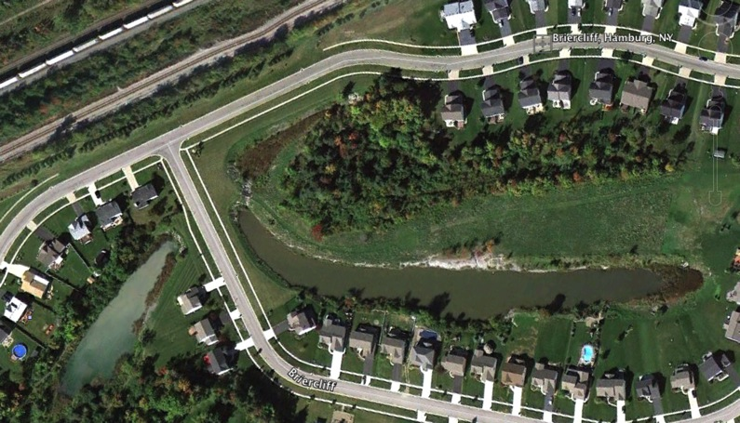
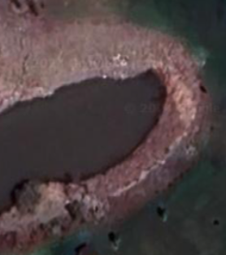
Large Pond East End Project:
Remove Growth and restore depth
Remediate Construction Damage
Move recovered pond spoils to East End of pond
to create level surface for mowable grass
GREENSPACE - The Ponds

Slide 10
ARCHITECTURAL APPROVALS
4 Architectural Requests
Approved
  2 sheds
  2 additions
Homeowners with structures on HOA property.
We addressed each of the situations based on their distinct circumstances (1 remains open – shed/fence)
The HOA is being added as an additional insured on the homeowner’s insurance policy
  The structures must be removed PRIOR to the homeowner selling
COMMITTEE REPORTS

Slide 11
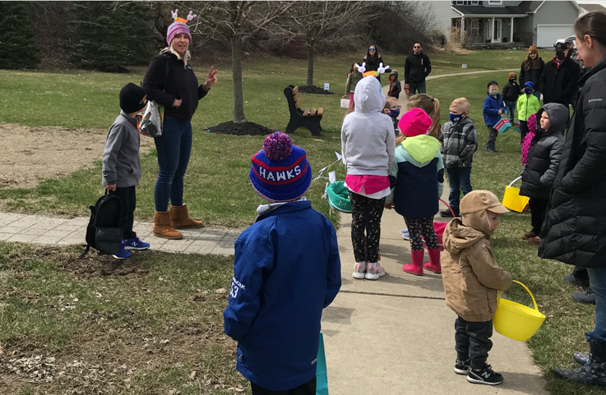
EVENTS COMMITTEE
We’re looking for someone to organize & run events for the neighborhood that we’ve had in the past such as
  An Easter egg hunt
  A chalk party
  Ice cream socials
Please consider volunteering!
COMMITTEE REPORTS

Slide 12
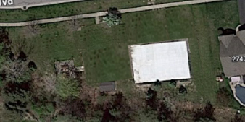

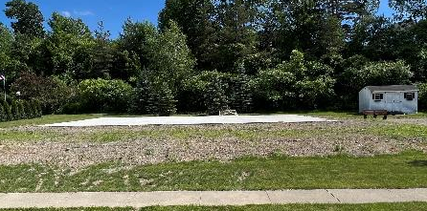
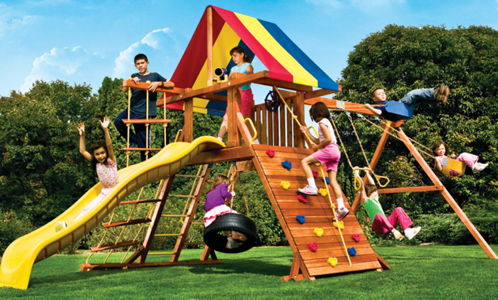
Playground
Proposed installation of a smaller play-set for 10-years or younger.
Donation of “Like New” Needed
Volunteers to install
Playground Set
Install Fence
10’ – Fence
5’– Fence
4’– Fence

Slide 13
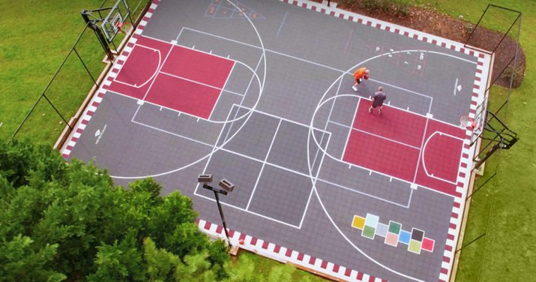
Sports & Events Court
Sports Court/Events Court
Safe place to play & gather
Available to ALL kids & All adults
Brings a LIFESTYLE to our community
Basketball, pickleball, 4-square, hockey, yoga, shuffle-board, etc.
We already have the storage shed
COMMITTEE REPORTS

Slide 14

Sports & Events Court
PHASE 1 - 2021 $21,000
1. 60’ x 40’ concrete slab $21,000
PHASE 2 - 2022 $9,479
Basketball hoops $4,348
Final grade/topsoil $2,298
Privacy trees $1,533
Rough grade/drainage $1,300
PHASE 3 - 2024 $9,250
Fencing $9,250
PHASE 4 To Be Determined
Custom sports court (volunteered installed)
COMMITTEE REPORTS
Notes:
80 tons of stone, 3 ft drop in elevation

Slide 15
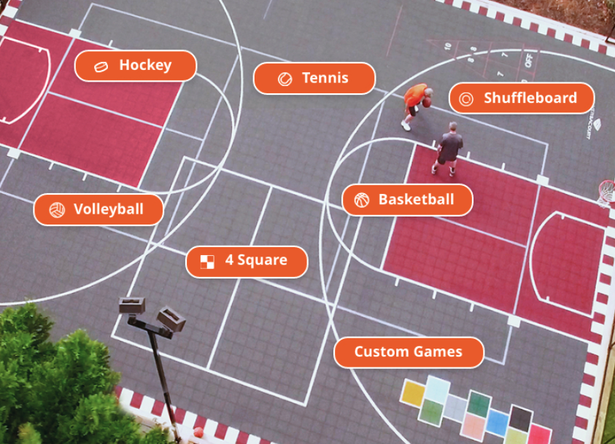
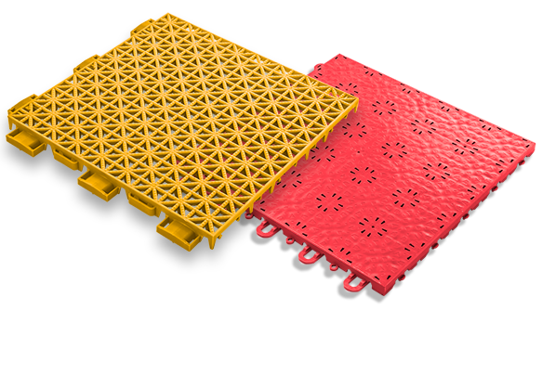
Sports & Events Court

Slide 16
Street Lighting
Street Lighting
  Replacement of streetlight heads
    The board will be researching options to replace the streetlight heads & possibly adding a base.
    There are 37 streetlights in our development. Rough estimates to replace the heads is $1,500 to $2,000 each.

Slide 17
Amsdell Road School Safety Project
The $550k in funding to address Cloverbank & Amsdell Road school safety issues is complete. Sidewalks and the crosswalk are completed at our entrance to Amsdell.

Slide 18
Culvert Flooding
Per discussions with the town, the county is responsible for clearing the culvert under the Amsdell Road entrance to prevent the flooding we’ve had in the past. The latest information we have is that the county was looking for a contractor to do the work.

Slide 19
General Neighborhood Reminders
Rules are on the website - BriercliffHomeowners.com
  Enforcement of the rules is necessary to maintain
  property values.
Facebook.com/BriercliffHOA
or search for BriercliffHOA on your Facebook page
  Request to Join

Slide 20
Good Neighbor Reminders
GARBAGE, BRUSH & LARGE TRASH
  Go out NO EARLIER than 6pm the day before (Wednesday)
  Brought in by the evening of the pick-up day (Thursday)
  REFUSE SERVICE PROVIDER
  Waste Management and Modern Disposal both provide totes for recycling. However, Waste Management picks up the recycling tote once every 2 weeks while Modern Disposal picks up every week.
  2. Clean up after your dog.
  3. To Host an event or social gathering at the recreation area, please SUBMIT a Waiver Application to reserve the space
LARGE TRASH PICK-UP Out on Wednesday night of the 3rd full week
April to October
BRUSH PICK-UP:
Out on SATURDAY before the 2nd full week
March to November

Slide 21
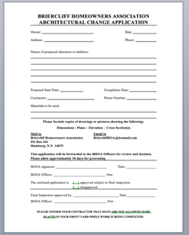
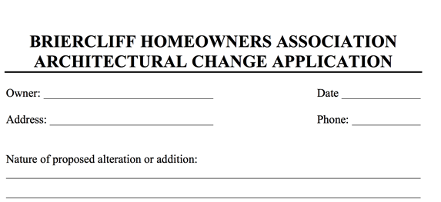
Paperwork Turnaround
If you are adding on to your home, please download and submit the Architectural Approval form at least 2-weeks prior to construction.
If you are selling your home, please have your closing attorney request your closing documents at least 2-weeks prior to your closing. We invoice your attorney a $30 document fee.
Pools
Sheds
Fences
Additions

Slide 22

Volunteering
Several Volunteer Opportunities
May – Earth Day clean up & brush cleanup around the ponds
Spring & Summer – Playground

Slide 23
2024 Actual vs Budget

Slide 24
Budget
  Dues to remain the same at $250/$125. Pay your dues via Zelle hoa@briercliffhomeowners.com or mail to: Briercliff Homeowners Association, PO Box 461, Hamburg, NY 14075.
  Board members, officers & volunteers do a lot of work to keep costs down.
  Current project is finishing the sports pad.
  Future projects are pond remediation & replacing the streetlights.
  Looking for donated playground for young children.
    The board has the authority to impose a special assessment.

Slide 25
2025 Budget
Notes:
Change in officer’s stipends.

Slide 26
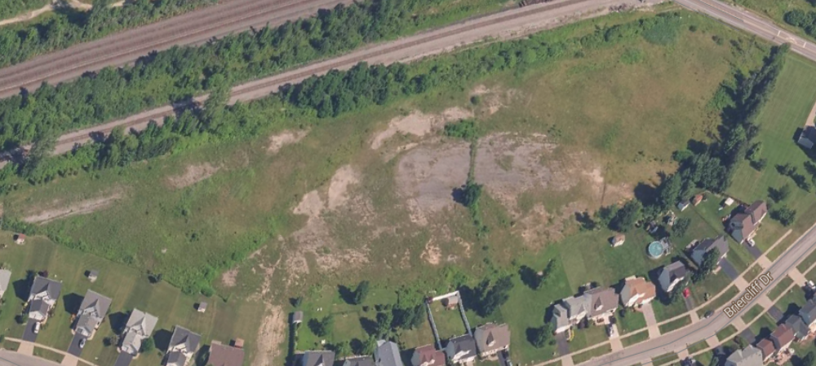
DATO Project by Tracks
The DATO Project has been Approved
We reduced it from 98-Units & two driveways to 56-Units and 1 driveway
We have been able to prove that they have over developed the PUD by not meeting their “undeveloped” (lawns) projections
  This was to possibly get them to abandon the DATO project and use it to cover “undeveloped space shortage” in order to keep building the mixed use project on Rogers.
However, The Official Signed Resolution which would state that they were required to meet their projections could not be located.
Therefore, the town had no document to use as enforcement with 100% certainty
Notes:
Planned Unit Development

Slide 27
VOTING RESULTS
Budget voting results:
Board member voting results:
Voting will be open until 9pm on December 12th. Final results will be emailed to all homeowners tomorrow night.
28 approved to 0 disapproved
Dennis Lanning 28
Patti Michalek 28
Write-in 0

Slide 28
THANK YOU

