Slide 1
ANNUAL MEETING December 13, 2023

Slide 2
HOA’S MISSION & ROLE
BOARD MEMBERS INTRODUCTIONS
COMMITTEE REPORTS
  SUNSHINE, GREEN SPACE, ARCHITECTURAL & EVENTS
AMSDELL ROAD SCHOOL SAFETY PROJECT
CULVERT FLOODING
RULES/PAPERWORK/VOLUNTEERING
2023 ACTUAL TO BUDGET REVIEW
2024 BUDGET & VOTE RESULTS
DATO DEVELOPMENT UPDATE
QUESTIONS & ANSWERS
AGENDA
Notes:
Read & Approve MINS – DON

Slide 3
HOMEOWNERS ASSOCIATION’S MISSION
To protect and enhance the VALUE of our homeowners’ property by ensuring architectural integrity, recreational greenspace and shared amenities providing benefits to all members of the Association.

Slide 4
HOMEOWNERS ASSOCIATION’S ROLE
1. Maintain a relationship with our homeowners and be a source of information.
2. Maintain relationship with bordering neighbors
  Town of Hamburg
  Cloverbank Country Club
  Sawgrass Court
  DATO Development (PUD by Tracks)
3. Responsible for our neighborhood aesthetics & maintenance

Slide 5
BOARD MEMBERS & OFFICERS
BOARD MEMBERS:
  Don Grundtisch
  Dennis Lanning
  Patti Michalek
OFFICERS:
  President: Don Grundtisch
  1st Vice President: Kyle Kraus
  2nd Vice President: Open
  Treasurer: Andrea Livsey
  Secretary: Open
INTRODUCTIONS

Slide 6
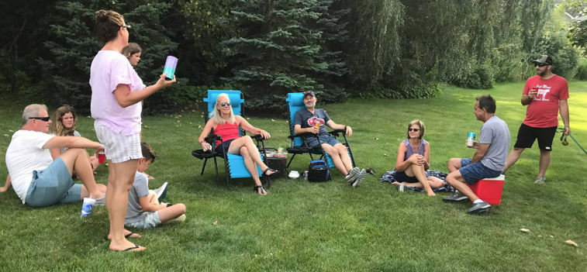
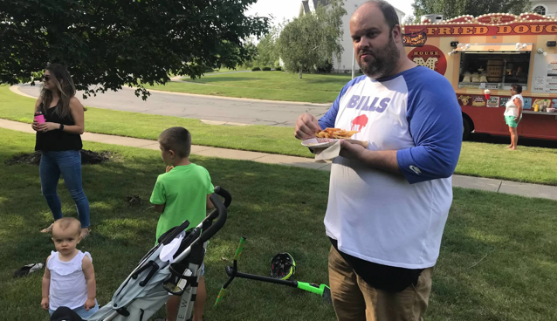
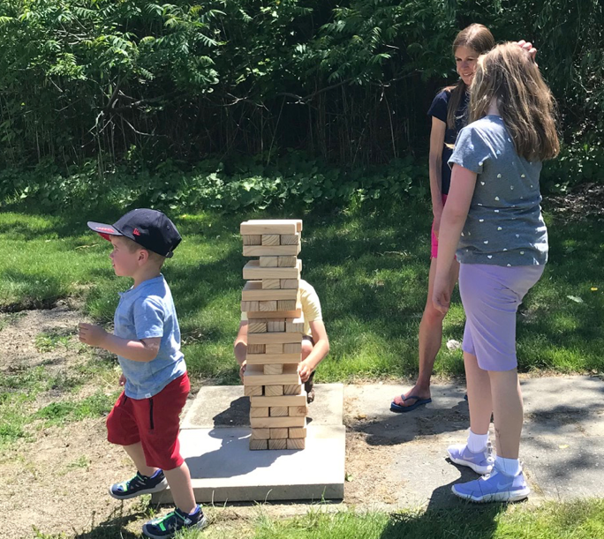
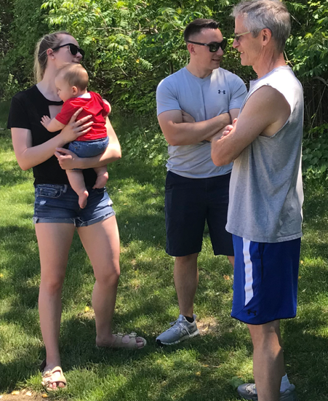
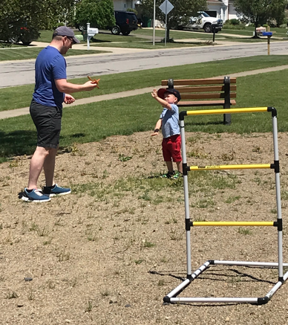
COMMITTEE REPORTS

Slide 7
SUNSHINE COMMITTEE
4 New Neighbors
Donna Lucas visits new homeowners to deliver gift bags & obtain contact information.
Anyone interested in joining the committee would be greatly appreciated!
Sunny dispositions wanted!
Thank you Donna!
COMMITTEE REPORTS

Slide 8
GREEN SPACE COMMITTEE
Pond Maintenance
  Cattails were removed from the eastern end of the large pond.
  The small pond & the western end of the large pond will be brush hogged in 2024.
Landscaping & Mowing
  Enser’s Lawn & Landscaping provides the landscaping & mowing service for our association.
  Price quote from Enser’s for 2024 increased by 4% from 2023.
COMMITTEE REPORTS

Slide 9
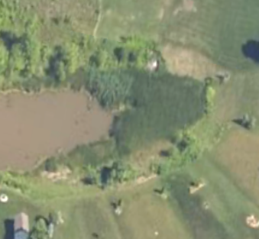
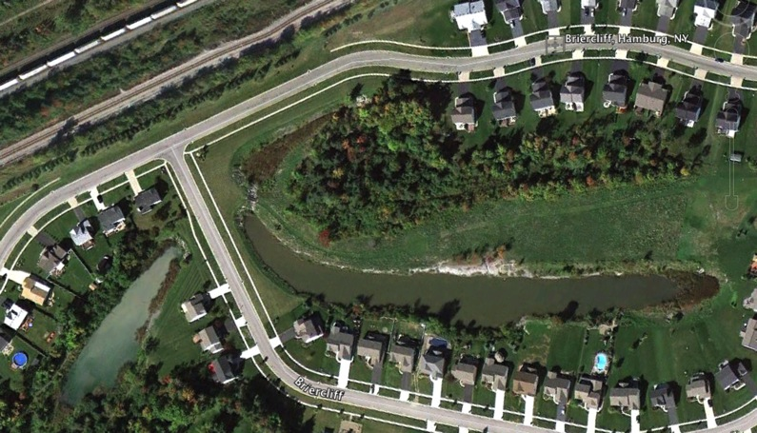
GREENSPACE - The Ponds

Slide 10
ARCHITECTURAL APPROVALS
5 Architectural Requests
Approved
  2 sheds
  2 fences
Homeowners with structures on HOA property.
We addressed each of the situations based on their distinct circumstances (1 remains open – shed/fence)
  The HOA is being added as an additional insured on the homeowner’s insurance policy
  The structures must be removed PRIOR to the homeowner selling
COMMITTEE REPORTS

Slide 11
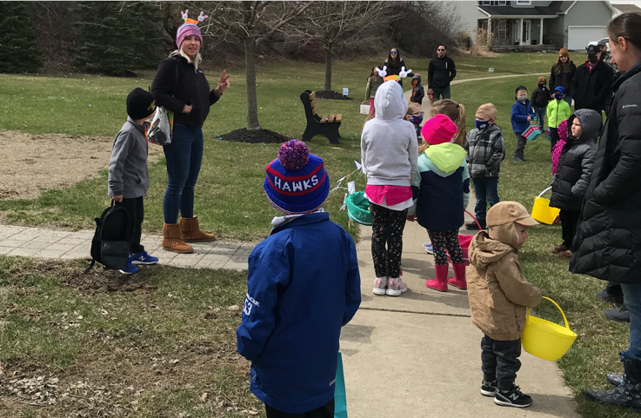
EVENTS COMMITTEE
Lindsay Wahler has organized & run a number of events for the neighborhood over the last few years including
  Easter egg hunt
  A chalk party
  Ice cream socials
More volunteers are needed
Thank you Lindsay!
COMMITTEE REPORTS

Slide 12
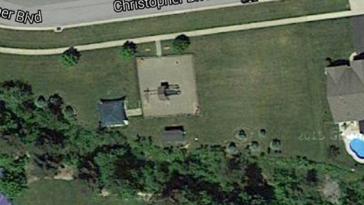

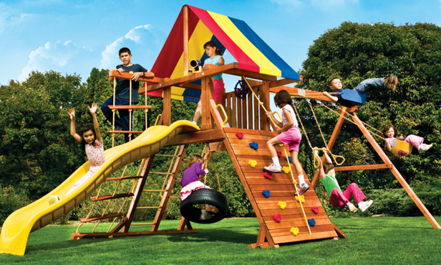
Playground
Proposed installation of a smaller play-set for 10-years or younger.
Donation of “Like New” Needed
Volunteers to install
Playground Set
Install Fence

Slide 13
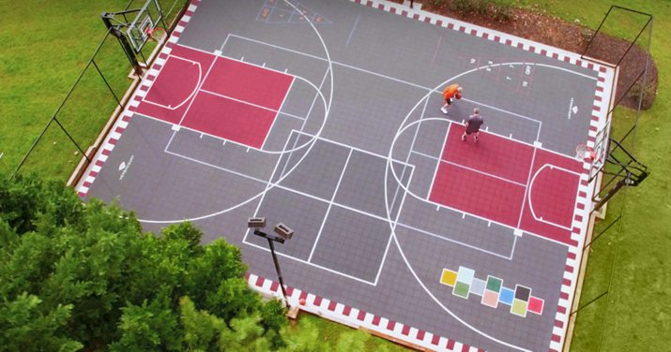
Sports & Events Court
Sports Court/Events Court
Safe place to play & gather
Available to ALL kids & All adults
Brings a LIFESTYLE to our community
Basketball, pickleball, 4-square, hockey, yoga, shuffle-board, etc.
We already have the storage shed
COMMITTEE REPORTS

Slide 14

Sports & Events Court
PHASE 1 - 2021 $21,000 ($30,000 @ $14/sq.ft.)
1. 60’ x 40’ concrete slab $21,000
PHASE 2 - 2022 $9,479
Basketball hoops $4,348
Final grade/topsoil $2,298
Privacy trees $1,533
Rough grade/drainage $1,300
PHASE 3 To Be Determined
Fencing $10k included in budget
Custom sports court (volunteered installed)
COMMITTEE REPORTS
Notes:
80 tons of stone, 3 ft drop in elevation

Slide 15
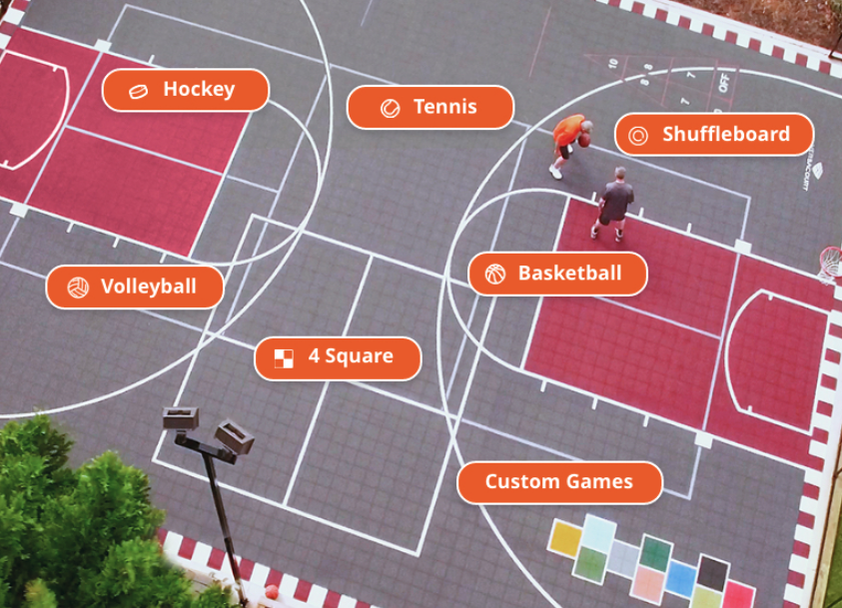
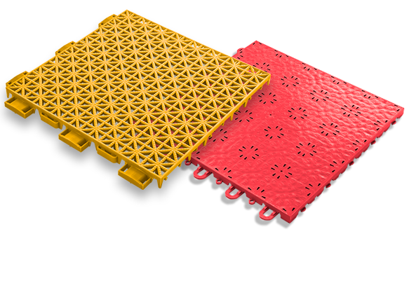
Sports & Events Court

Slide 16
Street Lighting
Street Lighting
  Town of Hamburg LED light project was completed.
  Replacement of streetlight heads
    The board will be researching options to replace the streetlight heads & possibly adding a base.
    There are 37 streetlights in our development. Rough estimates to replace the heads is $1,500 to $2,000 each.

Slide 17
Amsdell Road School Safety Project
Town has $550k in funding to address Cloverbank & Amsdell Road school safety issues. A committee was set up to determine the use of the funds - the vast majority of which will be spent on Amsdell Road. Don is on the committee along with fellow homeowners Elizabeth Farrell Lorentz (town councilwoman) & Karen Jones. The plan was finalized & will include sidewalks from the railroad overpass to Route 20 and the construction of traffic calming features like a chicane and the construction of 2 crosswalks. One of the crosswalks will be at our entrance at Amsdell. The committee has issued requests for proposals for this work.

Slide 18
Culvert Flooding
Per discussions with the town, the county is responsible for clearing the culvert under the Amsdell Road entrance to prevent the flooding we’ve had in the past. The latest information we have is that the county was looking for a contactor to do the work.

Slide 19
General Neighborhood Reminders
Rules are on the website - BriercliffHomeowners.com
  Enforcement of the rules is necessary to maintain
  property values.
Facebook.com/BriercliffHOA
or search for BriercliffHOA on your Facebook page
  Request to Join

Slide 20
Good Neighbor Reminders
GARBAGE, BRUSH & LARGE TRASH
  Go out NO EARLIER than 6pm the day before (Wednesday)
  Brought in by the evening of the pick-up day (Thursday)
  REFUSE SERVICE PROVIDER
  Waste Management and Modern Disposal both provide totes for recycling. However, Waste Management picks up the recycling tote once every 2 weeks while Modern Disposal picks up every week.
  2. Clean up after your dog.
  3. To Host an event or social gathering at the recreation area, please SUBMIT a Waiver Application to reserve the space
LARGE TRASH PICK-UP Out on Wednesday night of the 3rd full week
April to October
BRUSH PICK-UP:
Out on SATURDAY before the 2nd full week
March to November

Slide 21
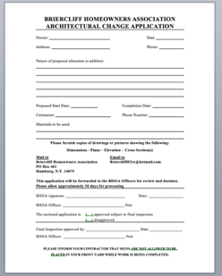
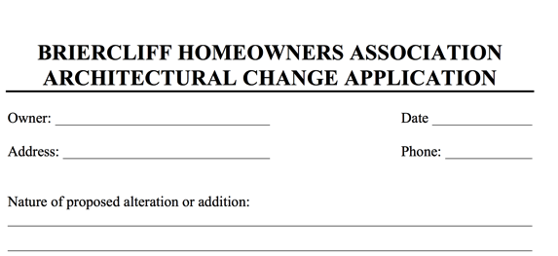
Paperwork Turnaround
If you are adding on to your home, please download and submit the Architectural Approval form at least 2-weeks prior to construction.
If you are selling your home, please have your closing attorney request your closing documents at least 2-weeks prior to your closing. We invoice your attorney a $30 document fee.
Pools
Sheds
Fences
Additions

Slide 22

Volunteering
Several Volunteer Opportunities
May – Earth Day clean up & brush cleanup around the ponds
Spring & Summer – Playground

Slide 23
2023 Actual vs Budget

Slide 24
Budget
  Dues to remain the same at $250/$125.
  Board members, officers & volunteers do a lot of work to keep costs down.
  Current project is finishing the sports pad.
  Future projects are pond remediation & replacing the streetlights.
  Looking for donated playground for young children.
    The board has the authority to impose a special assessment.

Slide 25
2024 Budget
Notes:
Change in officer’s stipends.

Slide 26
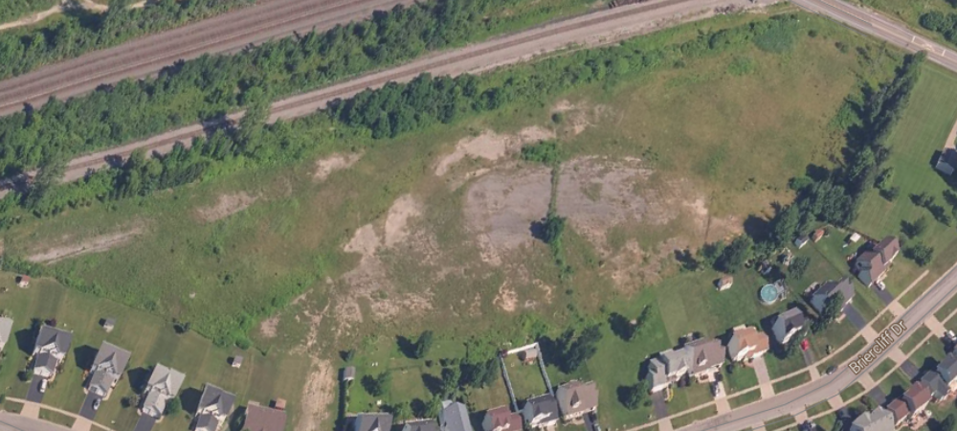
PUD Property by Tracks
Notes:
Planned Unit Development

Slide 27
Briercliff Townhomes
Approval Procedure (§230)
The project is a townhouse project & must adhere to those requirements.
At the 04/05/23 planning board meeting, DATO presented a plan reducing the number of units from 96 to 57.
Public hearings were held in Jan & Sept.
In Nov, the planning board issued a negative declaration - they believe the project will not have significant adverse effects on the environment. In addition, the planning board stated that DATO has met the required 27 acres of open space based on the original agreement.

Slide 28
0 Briercliff Townhomes
STATUS
    DATO has requested SIX variances from the Zoning Board of Appeals.
      We are going to fight the variances – if successful, they will have to reduce the number of townhomes in order to meet “Current Building Code Standards”
    If the ZBA approves All six Variance Requests, DATO will request approval on a Preliminary Plat from the planning board.
    If Preliminary Plat is approved, the next step is for DATO to submit engineering specifications which will need to be approved by the town engineering department and Erie Country Water and Sewer.
Notes:
Lot area, front yard setback, side yard setbacks (2), back yard setback & patio size

Slide 29
VOTING RESULTS
Budget voting results:
Board member voting results:
Voting will be open until 9pm on December 14th. Final results will be emailed to all homeowers tomorrow night.
21 approved to 0 disapproved
Don Grundtisch 20
Kyle Kraus 20
Write-in - Matt Maciejewski 2

Slide 30
THANK YOU

